Slide 1


Slide 2
Azure and ServiceNow – Better Together
Notes:
“You have Azure, and your company is currently evaluating ServiceNow (or maybe has already deployed it). Join this session to learn how to take advantage of these two platforms, and join them for ultimate Service Management Process Automation!
You’ll learn how to connect these two platforms, as well as pass data to/from each one to handle automated tasks (for example responding to a monitoring alert, or ‘break glass’ for server access). This demo-heavy session will show how to connect these two platforms using Logic Apps, Azure Automation and Azure Functions with ServiceNow.”

Slide 3

Greg Ramsey
Senior Architect, Dell Technologies
Microsoft MVP, Enterprise Mobility
ramseyg@Hotmail.com
@ramseyg

Slide 4
Agenda
The Goal
Why?
How? & Demos!

Slide 5
The Goal

Slide 6
The Goal
Transaction-based, real time integration
Azure
ServiceNow
Data Center
Logic Apps Gateway
Hybrid Runbook Worker
MID Server
Notes:
Graphic showing ServiceNow and Azure clouds

Slide 7
Why?

Slide 8
Why.
Azure
ServiceNow
Management
Monitoring
Automation
Events
ATA
…..
Incident Mgmt
Change Mgmt
Business Process Automation
Approval Workflows
Discovery/Asset Mgmt
……
Notes:
Reducing time to resolve

Slide 9
A word (or two) on security….
Web Hooks
OAUTH
IAM
Service Accounts
…….

Slide 10
ServiceNow Tips - REST API Explorer is your friend
Developer instances are free
ServiceNow REST API Explorer is your friend
Get/Set from standard tables
Building Queries
“Cheat Code”

Slide 11
Demos!

Slide 12
Demo 0
Developer Instance Tips
API Explorer
ServiceNow

Slide 13
Demo 1
Azure Event Generates ServiceNow Incident
Azure
ServiceNow
Logic Apps
Azure Event
Incident

Slide 14
Demo 2
Incident enrichment in ServiceNow for VM in Azure
Azure
ServiceNow
Logic Apps
Azure VM
Incident

Slide 15
Demo 2 Steps
Create web hook in Logic Apps
ServiceNow: Create action and flow
Grant rights for logic app web hook to Azure Resource Group
Build out Logic App
Query SN for INC Details
Query SN for Configuration Item (Server) details
Query Azure for VM Status
Enrich Incident in ServiceNow
Bonus*
Notes:
Trigger event on new server provisioned, or deleted?

Slide 16
Slides and demos from the conference will be available at
https://github.com/nordicinfrastructureconference/2020

Slide 18
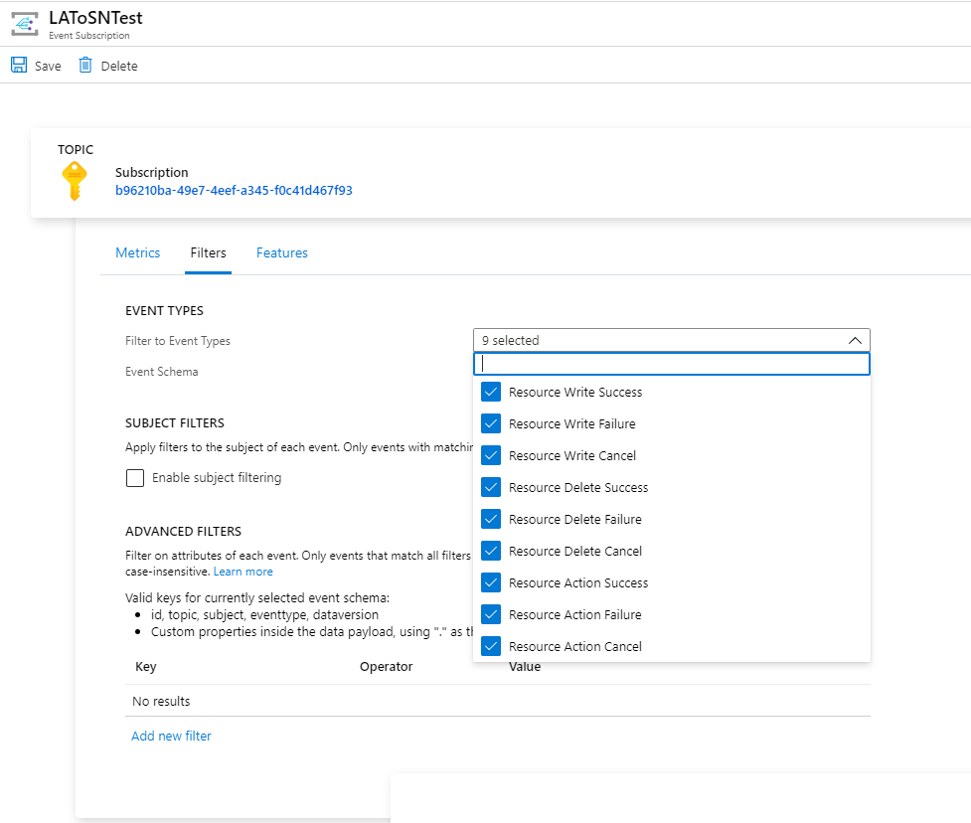

Slide 19
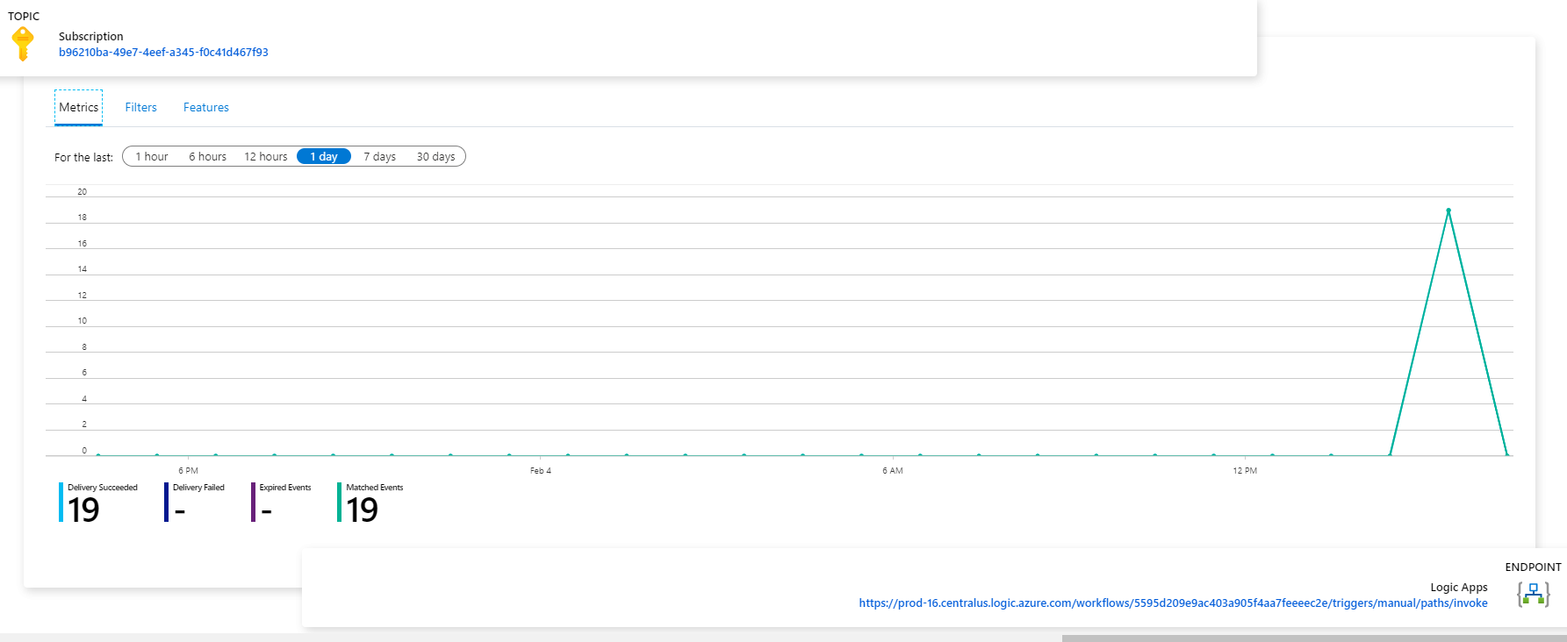

Slide 20
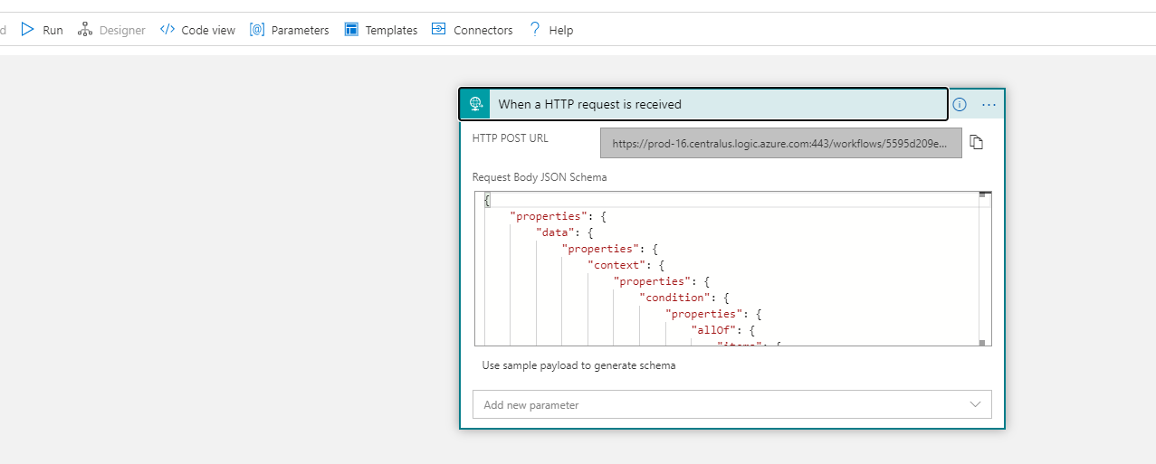

Slide 21
Demo2
Notes:
Servicenow – incident is updated, trigger automation to do something.

Slide 22
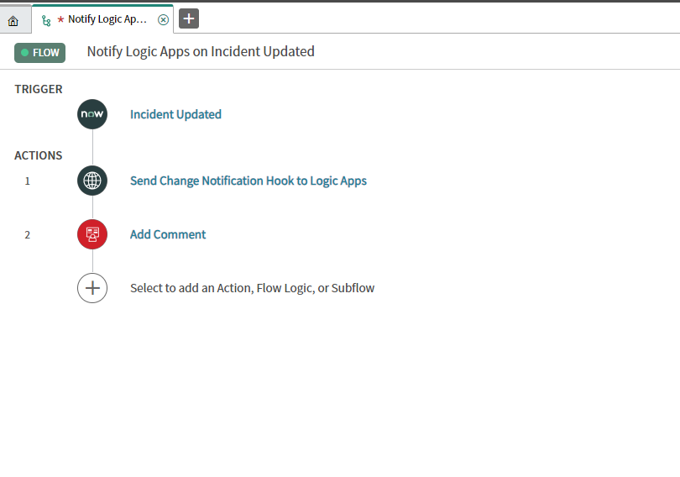

Slide 23
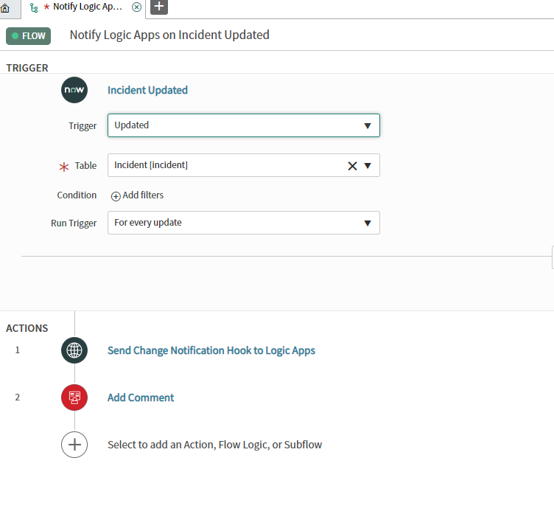

Slide 24
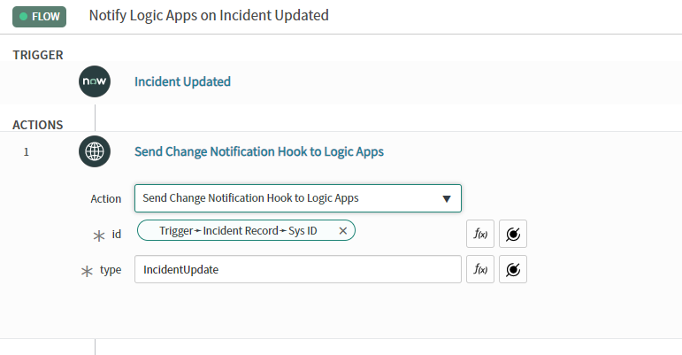

Slide 25
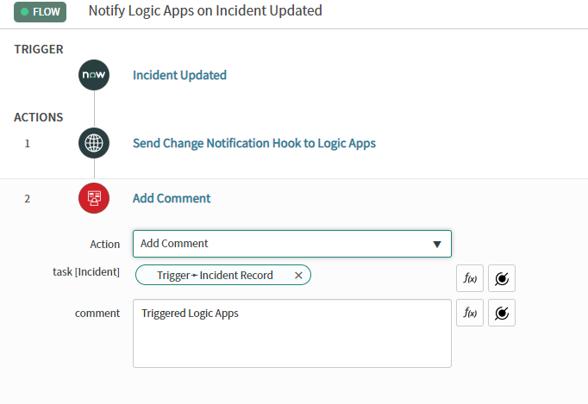

Slide 26
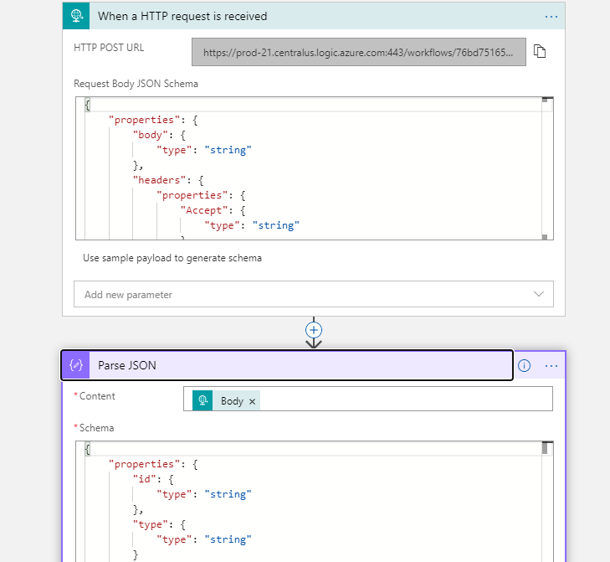

Slide 27
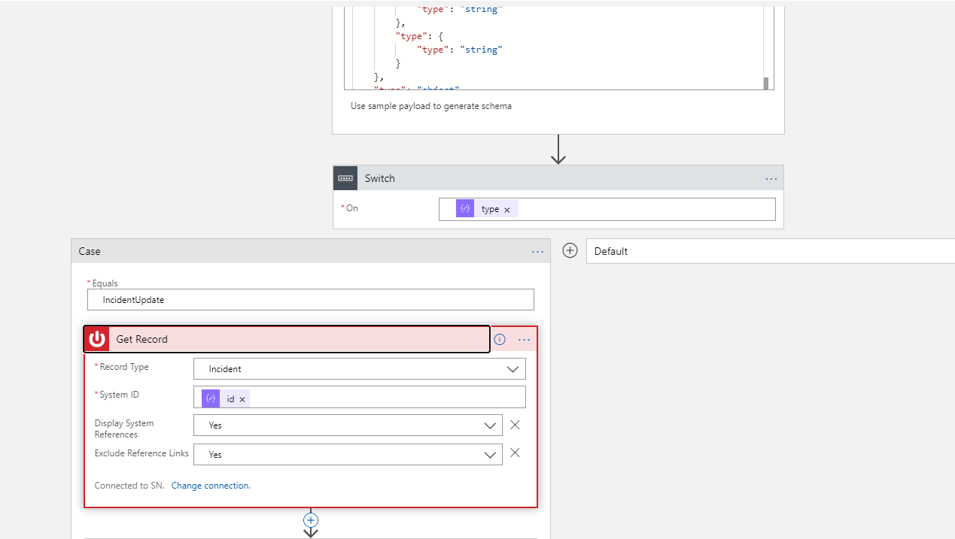

Slide 28
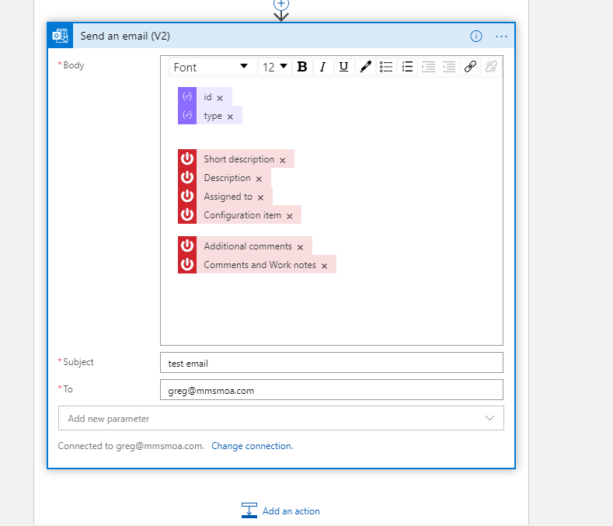

Slide 29
Potential enhancements – go query azure for device health
Ping test, if can’t connect, and is non-prod, power off/on

Slide 30
Slides and demos from the conference will be available at
https://github.com/nordicinfrastructureconference/2020

